Slide 1
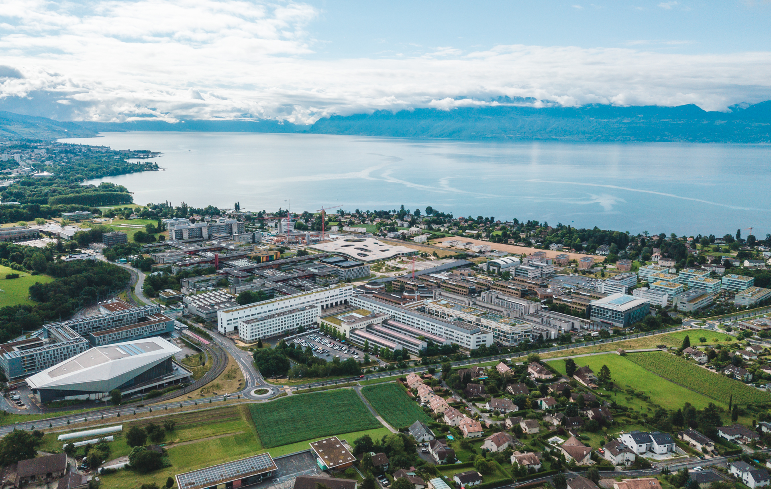
(3+1)D Printing of Volume Holograms
Optica Digital Holography and 3-D Imaging Meeting, Cambridge, UK
Niyazi Ulas Dinc^{1,2}, Christophe Moser² and Demetri Psaltis¹
¹ Laboratory of Optics, EPFL
² Laboratory of Applied Photonics Devices, EPFL
August 2, 2022

Slide 2
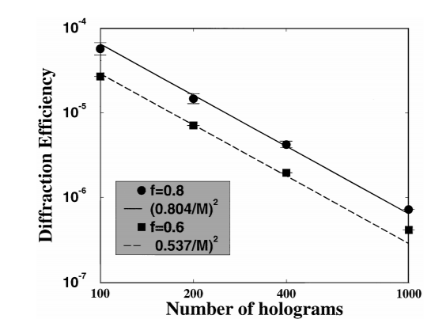
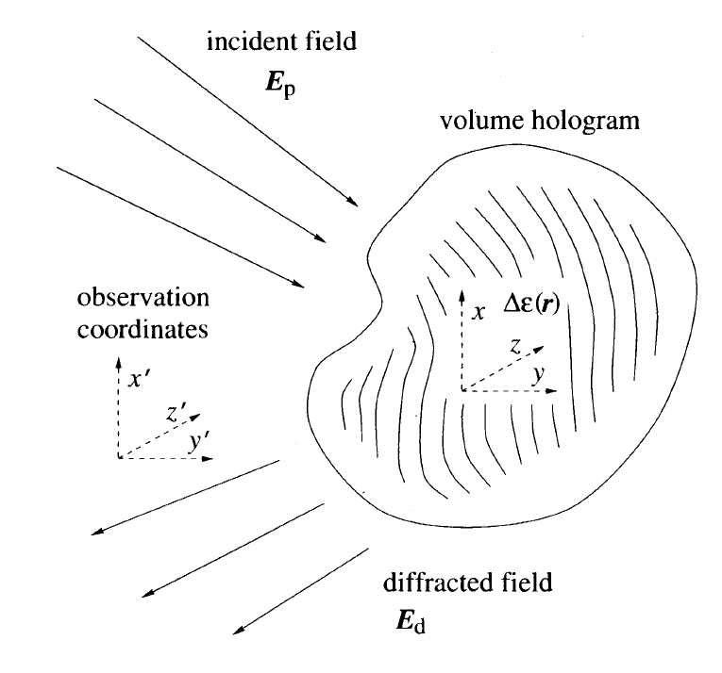
Volume holograms
2
DC
Noise
Conjugate
Reconstruction
John H. Hong, Pochi Yeh, Demetri Psaltis, and David Brady, "Diffraction efficiency of strong volume holograms," Opt. Lett. 15, 344-346 (1990)
Fai H. Mok, Geoffrey W. Burr, and Demetri Psaltis, "System metric for holographic memory systems," Opt. Lett. 21, 896-898 (1996)

Slide 3
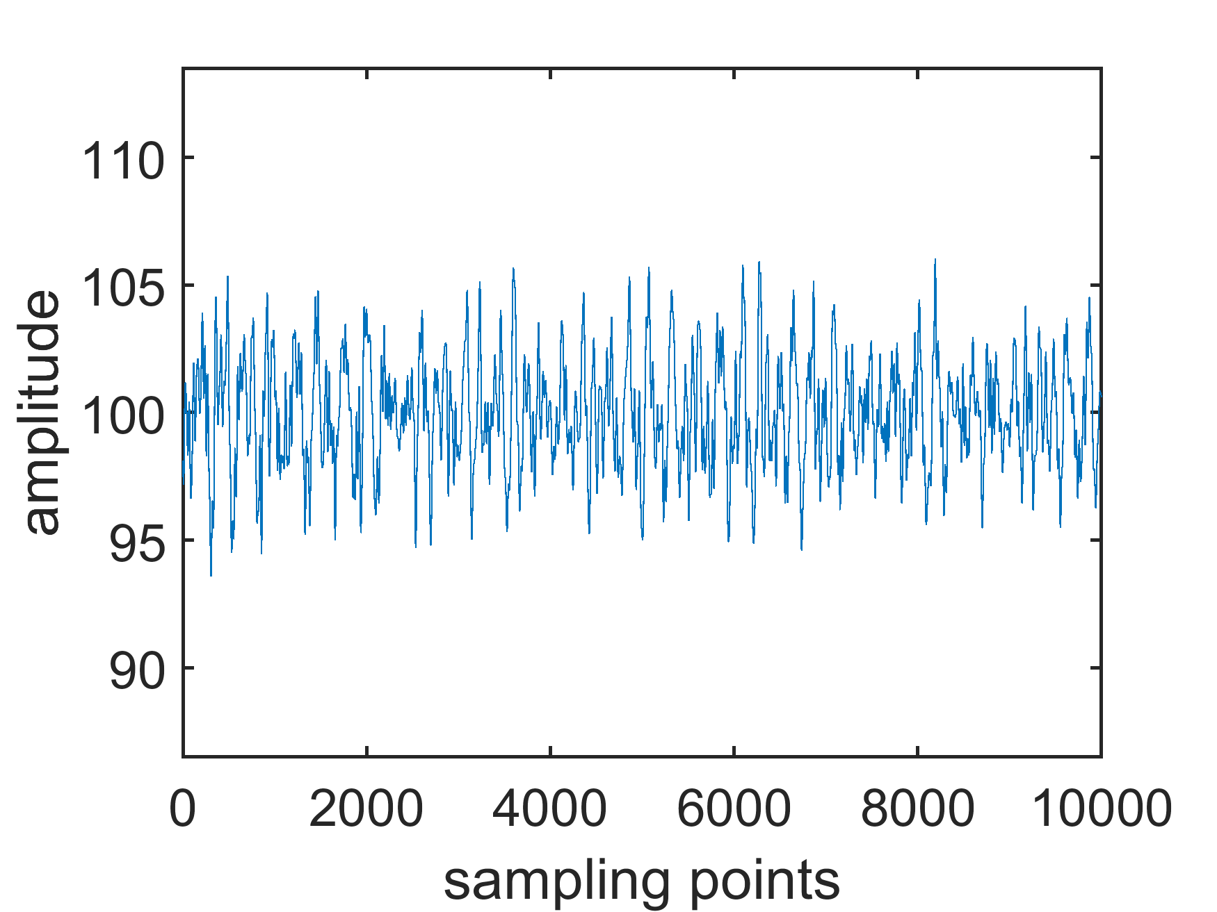
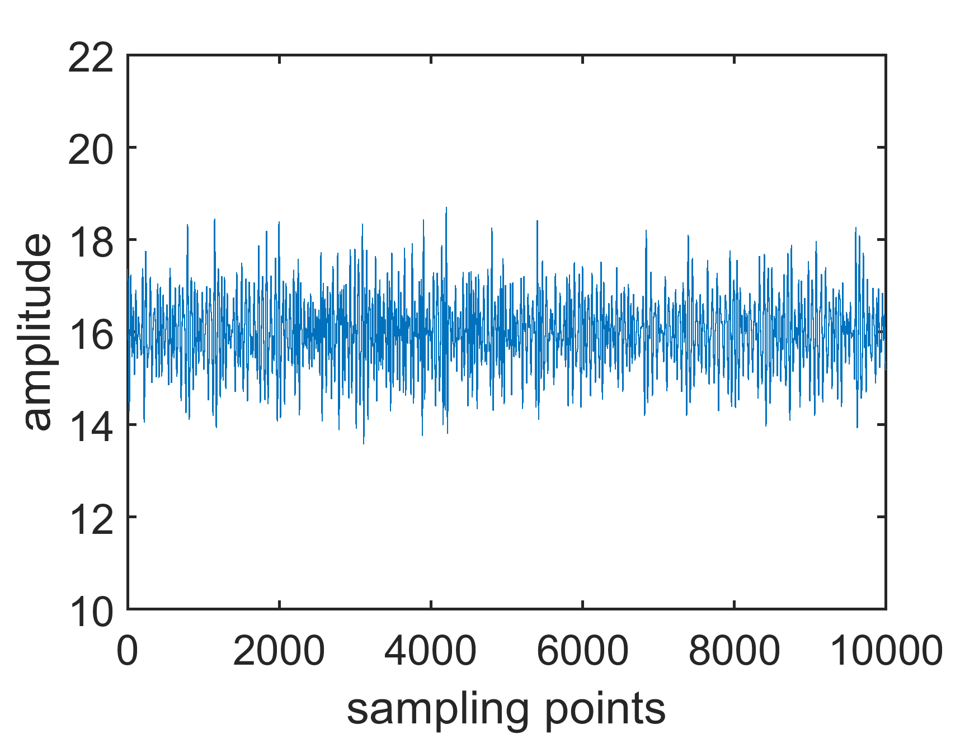





Efficiency
$$M=16$$
$$M=100$$
$$\sim \sqrt{M}$$
$$\sim \sqrt{M}$$
$$\sim M$$
$$\sim M$$

Slide 4
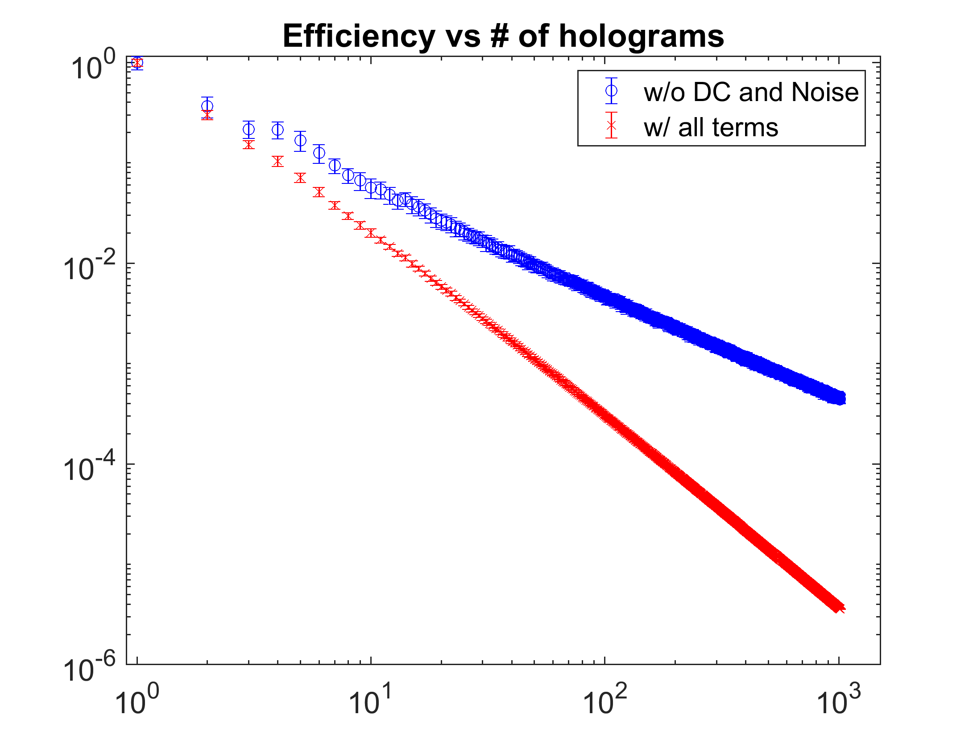


Efficiency
Computed curves with random envelopes*
$$slope≈−1$$
Efficiency
$slope≈−$2
# of holograms
*averaged over 100 realizations for each data point

Slide 5
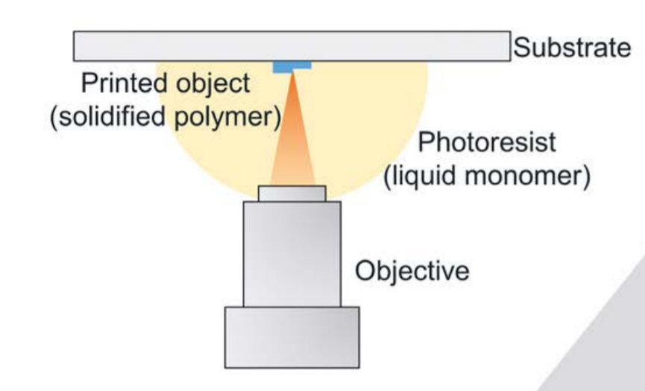
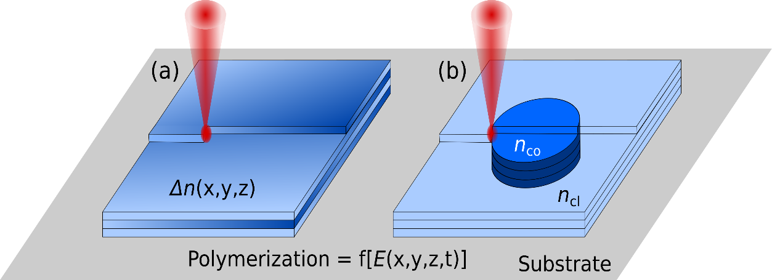
(3+1)D Printing by 2-photon polymerization
5
Voxel by voxel
Exposure dependent index
Sufficient resolution
Dinc NU, Psaltis D, & Brunner D. (2020). Optical neural networks: the 3D connection. Photoniques, (104), 34-38.
Porte X, Dinc NU, Moughames J, Panusa G, Juliano C, Kadic M, Moser C, Brunner D, Psaltis D. Direct (3+1)D laser writing of graded-index optical elements. Optica. 2021 Oct 20;8(10):1281-7.

Slide 6
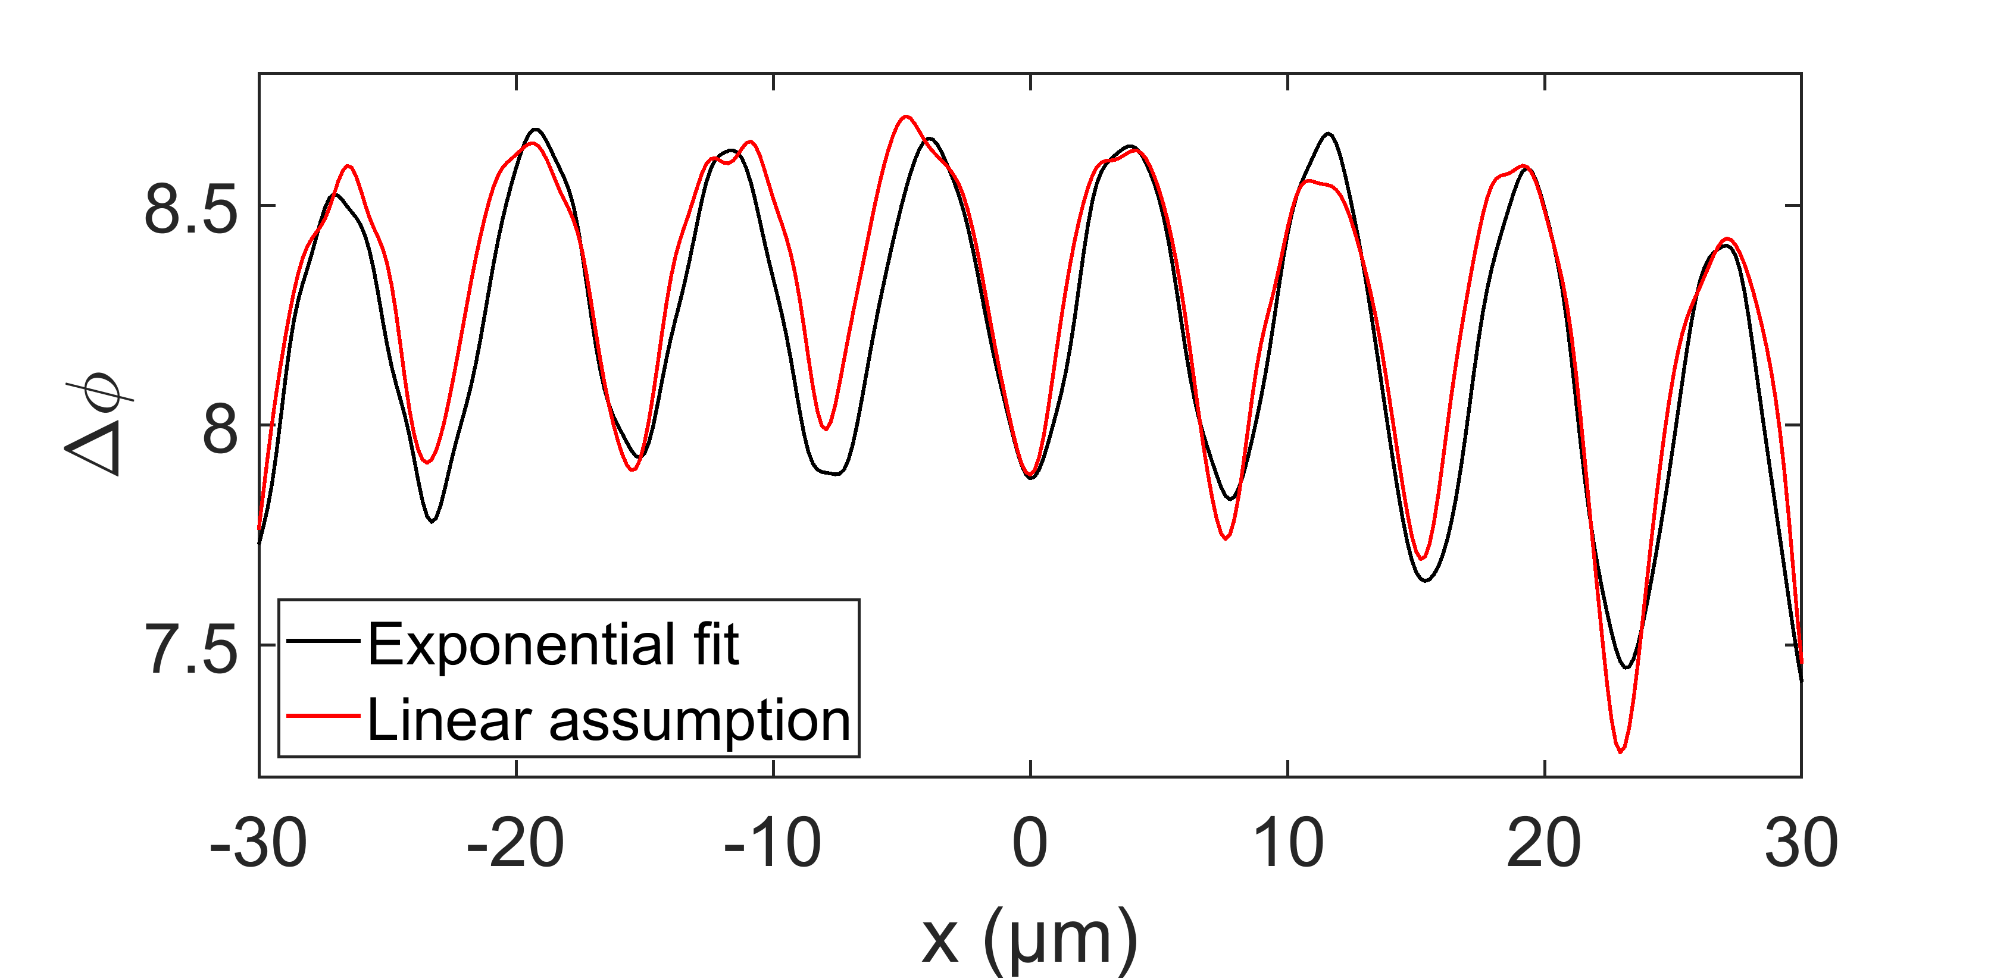
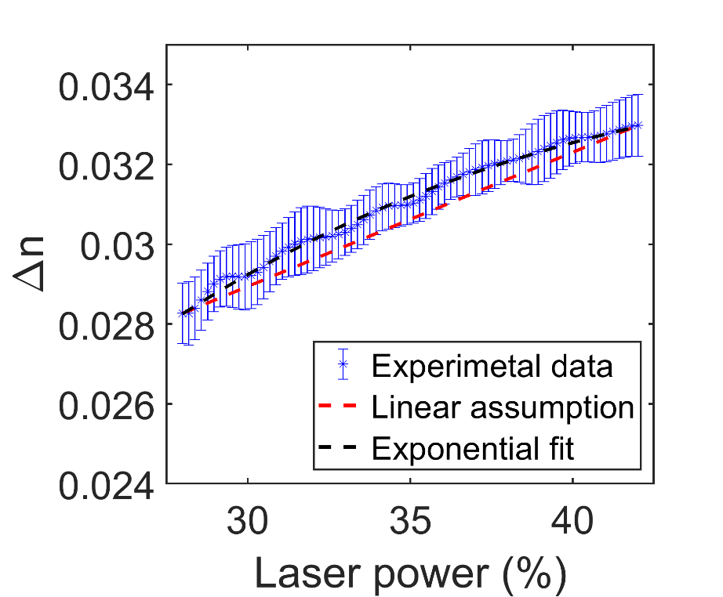

Calibration
6
Porte X, Dinc NU, Moughames J, Panusa G, Juliano C, Kadic M, Moser C, Brunner D, Psaltis D. Direct (3+1)D laser writing of graded-index optical elements. Optica. 2021 Oct 20;8(10):1281-7.

Slide 7
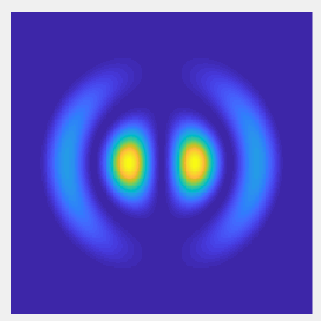
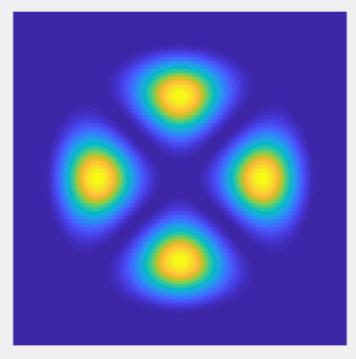
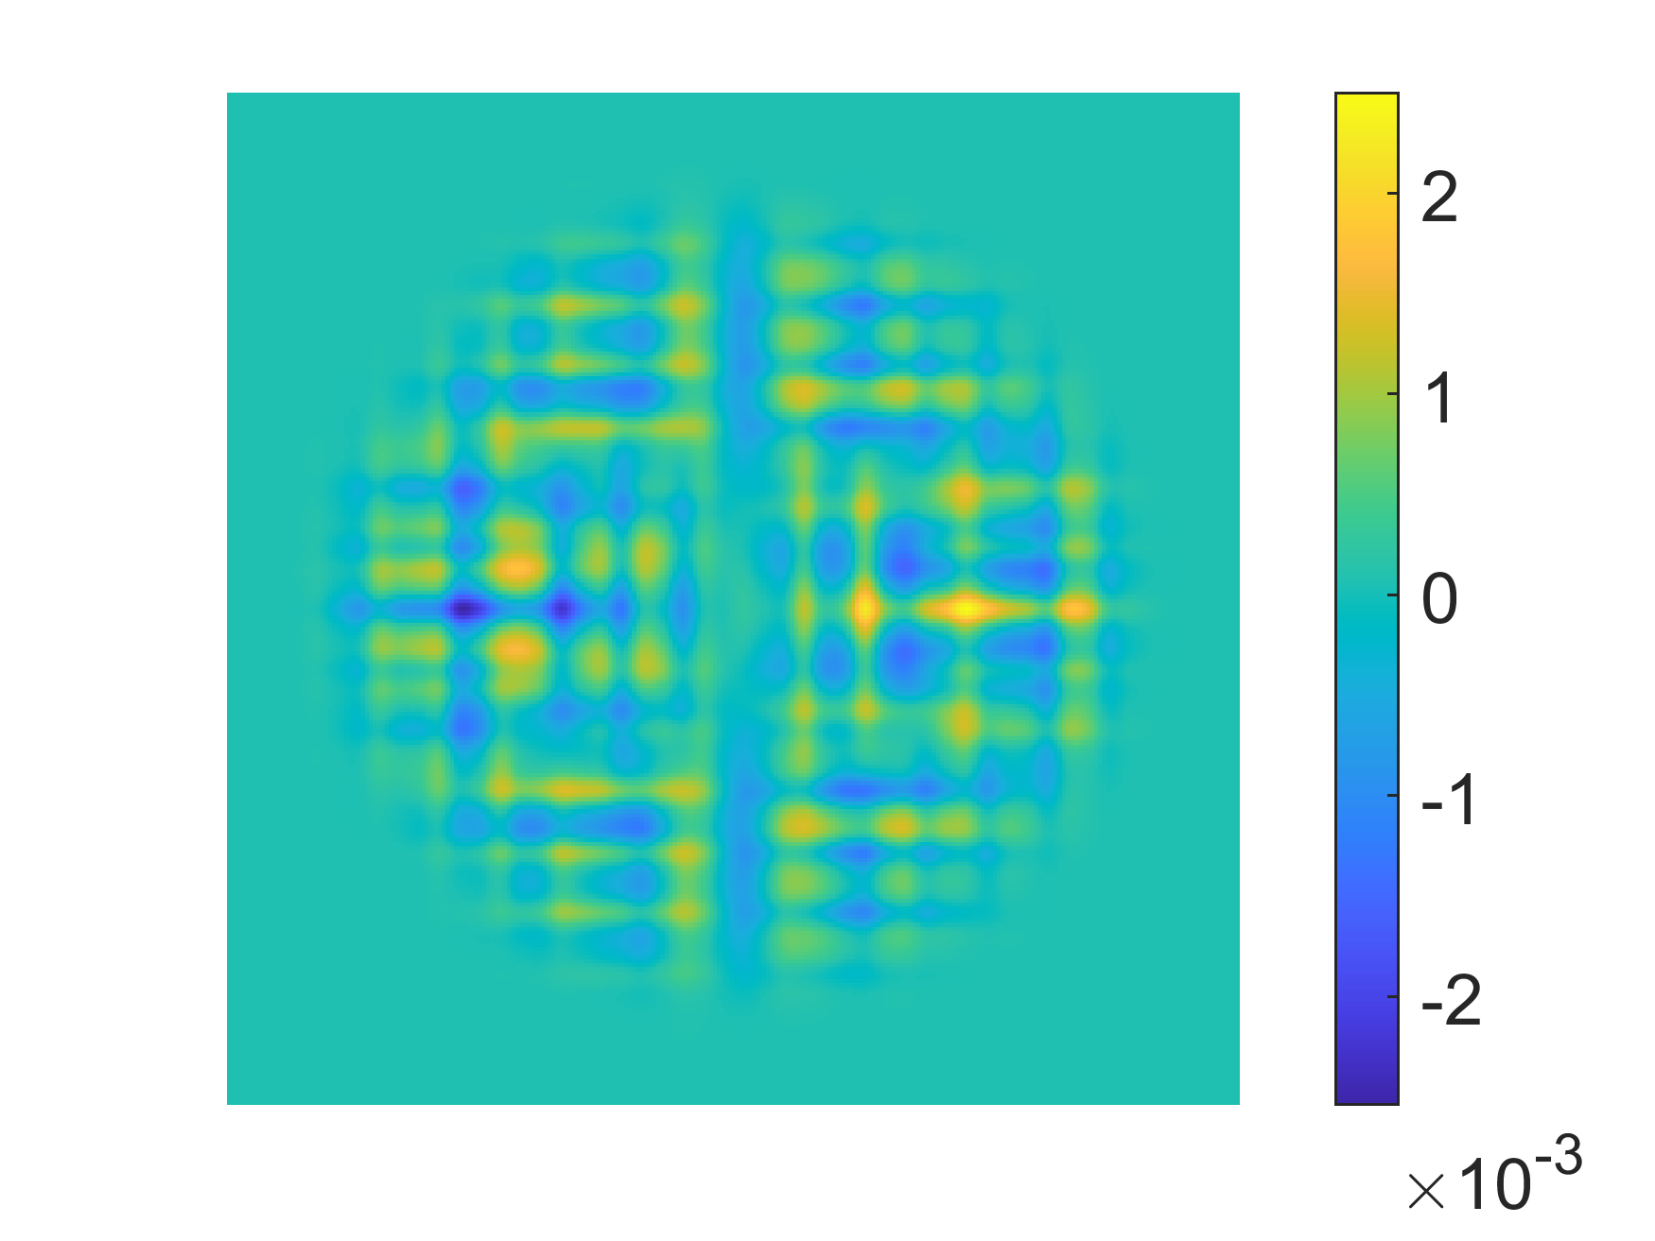
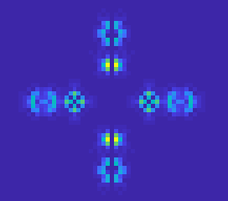
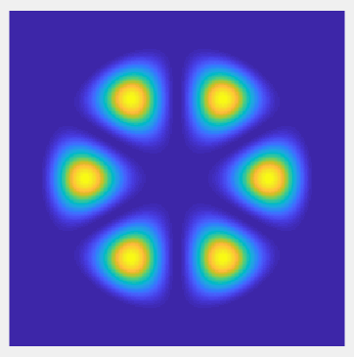
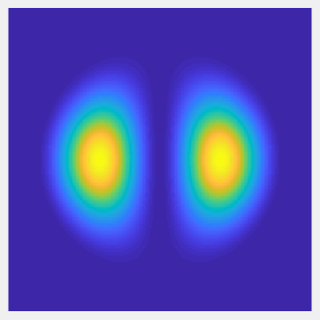

Digital generation to multiplex 4 patterns
$$50×50 {μm}^{2}$$
Porte X, Dinc NU, Moughames J, Panusa G, Juliano C, Kadic M, Moser C, Brunner D, Psaltis D. Direct (3+1)D laser writing of graded-index optical elements. Optica. 2021 Oct 20;8(10):1281-7.

Slide 8
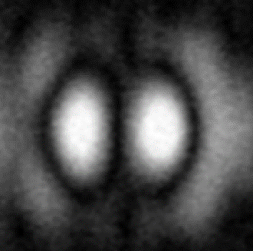
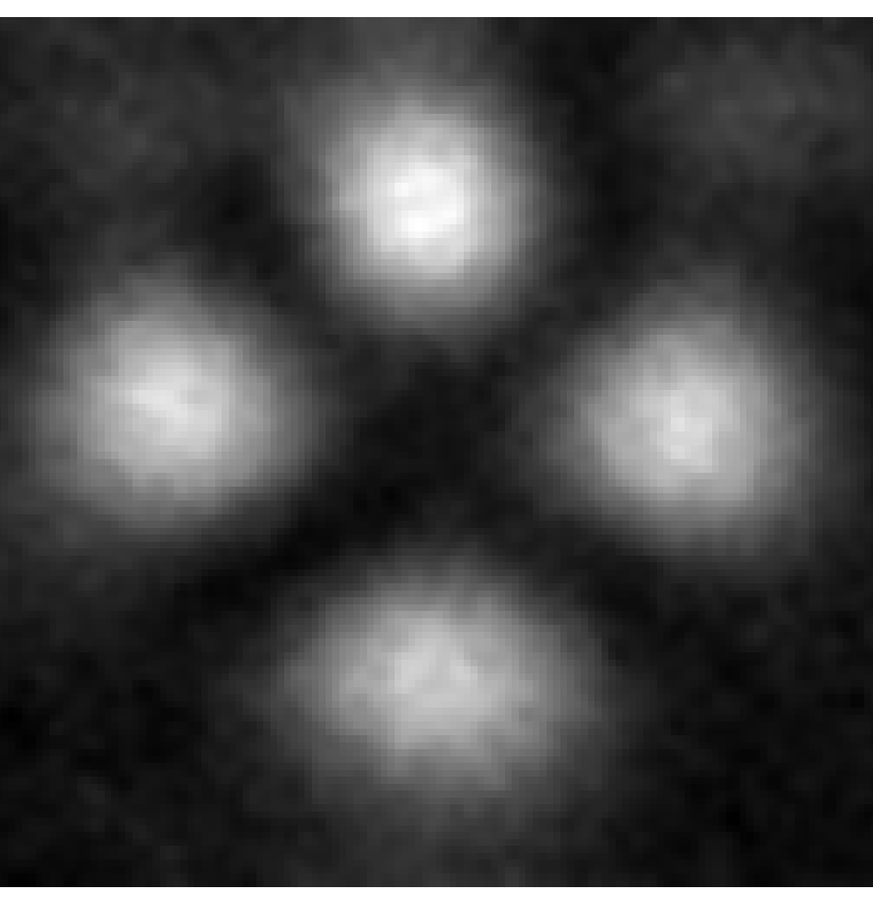
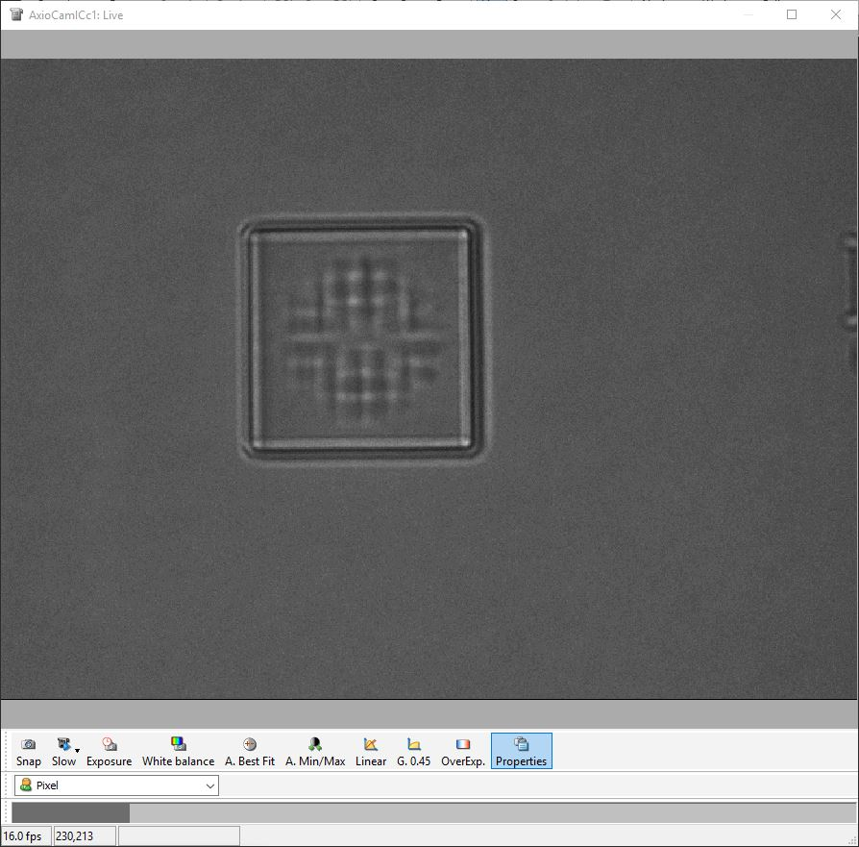
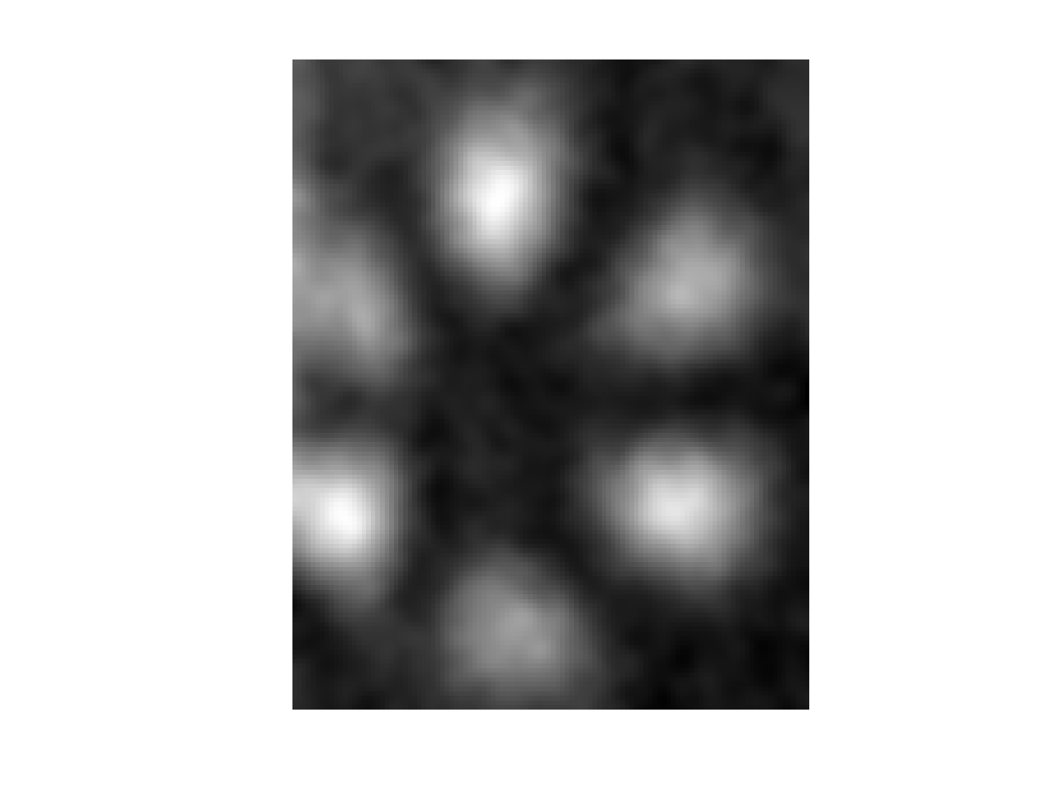
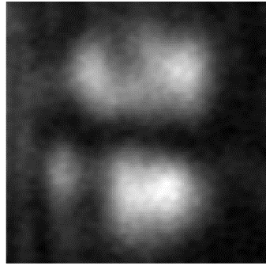

(3+1)D Printing to multiplex 4 patterns
8
Bright field microscope image
Experimental results
Dimensions (XYZ):
$$50×50×60 {μm}^{3}$$
Porte X, Dinc NU, Moughames J, Panusa G, Juliano C, Kadic M, Moser C, Brunner D, Psaltis D. Direct (3+1)D laser writing of graded-index optical elements. Optica. 2021 Oct 20;8(10):1281-7.

Slide 9
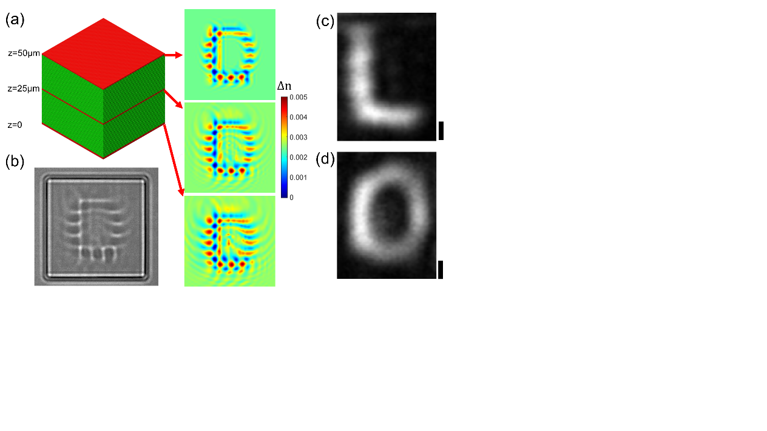

(3+1)D Printing to multiplex letters L and O
9
Bright field microscope image
Experimental results
Dimensions (XYZ):
$$50×50×50 {μm}^{3}$$
Scale bars measure 5 μm.
Porte X, Dinc NU, Moughames J, Panusa G, Juliano C, Kadic M, Moser C, Brunner D, Psaltis D. Direct (3+1)D laser writing of graded-index optical elements. Optica. 2021 Oct 20;8(10):1281-7.

Slide 10
Resolution constraint
10
Λ=10 µm
Λ=5 µm
IP-S unslanted gratings
Λ=3 µm
Λ=2 µm
Λ=0.8 µm
Manuscript under preparation.
Notes:
sinusoidals

Slide 11
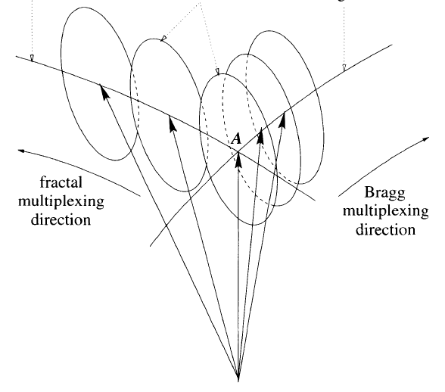
Number of possible holograms using IP-S
11
Multiplexing schemes:
Angular
Peristrophic
Combined
Coufal, Hans J., and Demetri Psaltis. Holographic data storage. Ed. Glenn T. Sincerbox. Vol. 8. New York: Springer, 2000.

Slide 12
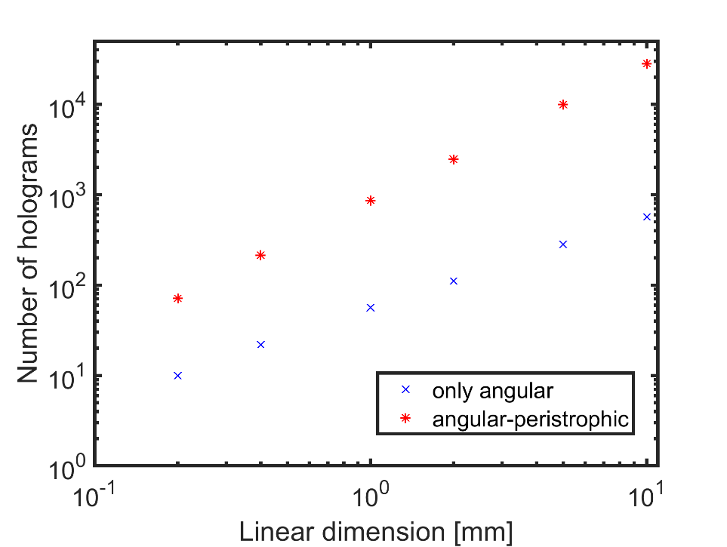
Number of possible holograms using IP-S
12
Dimension | Angular* | Combined* | Pixel number**
(0.2 mm)³ | 10 | 69 | ~220
(0.4 mm)³ | 20 | 215 | ~440
(1 mm)³ | 50 | 860 | ~1100
(1 cm)³ | 502 | 28142 | ~4400
*For λ=681nm and Λ_{min}=2µm
**Calculated signal bandwidth to satisfy zero cross-talk for peristrophic multiplexing
Manuscript under preparation.

Slide 13
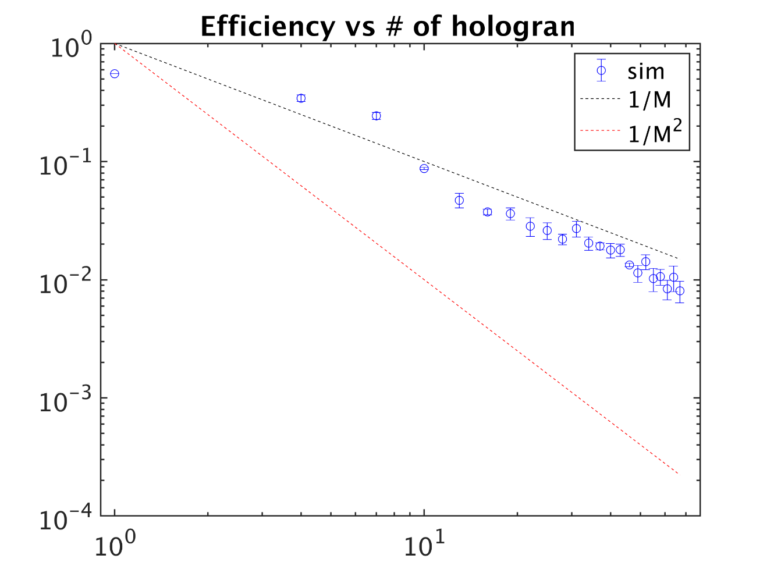
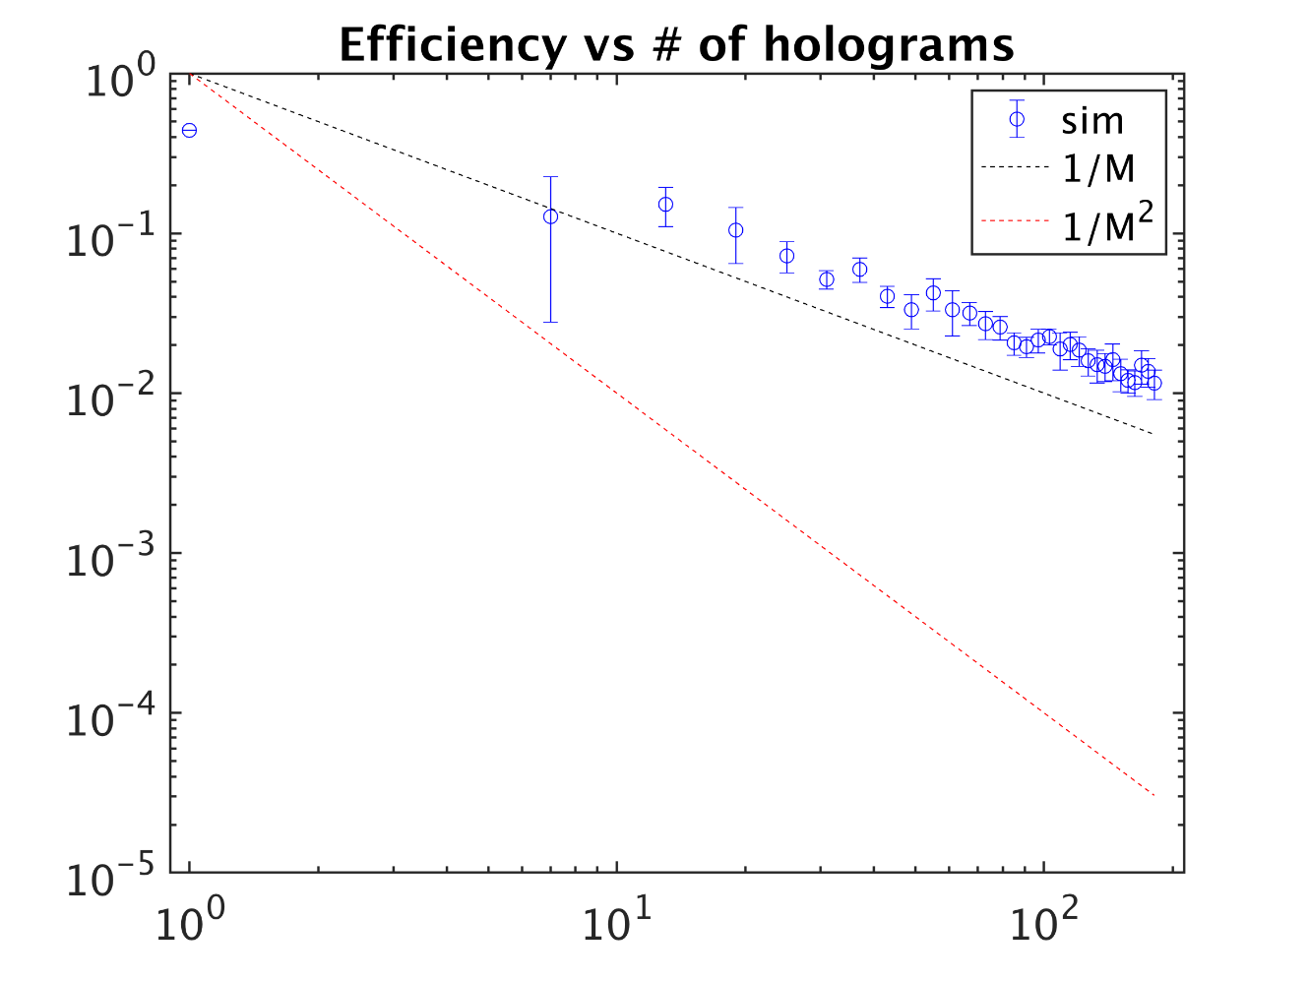
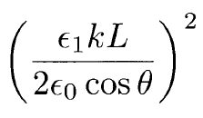
BPM verification of 1/M for angular-peristrophic multiplexing
13
~70 angles multiplexed in (200µm)³
~200 angles multiplexed in (400µm)³
Manuscript under preparation.

Slide 14
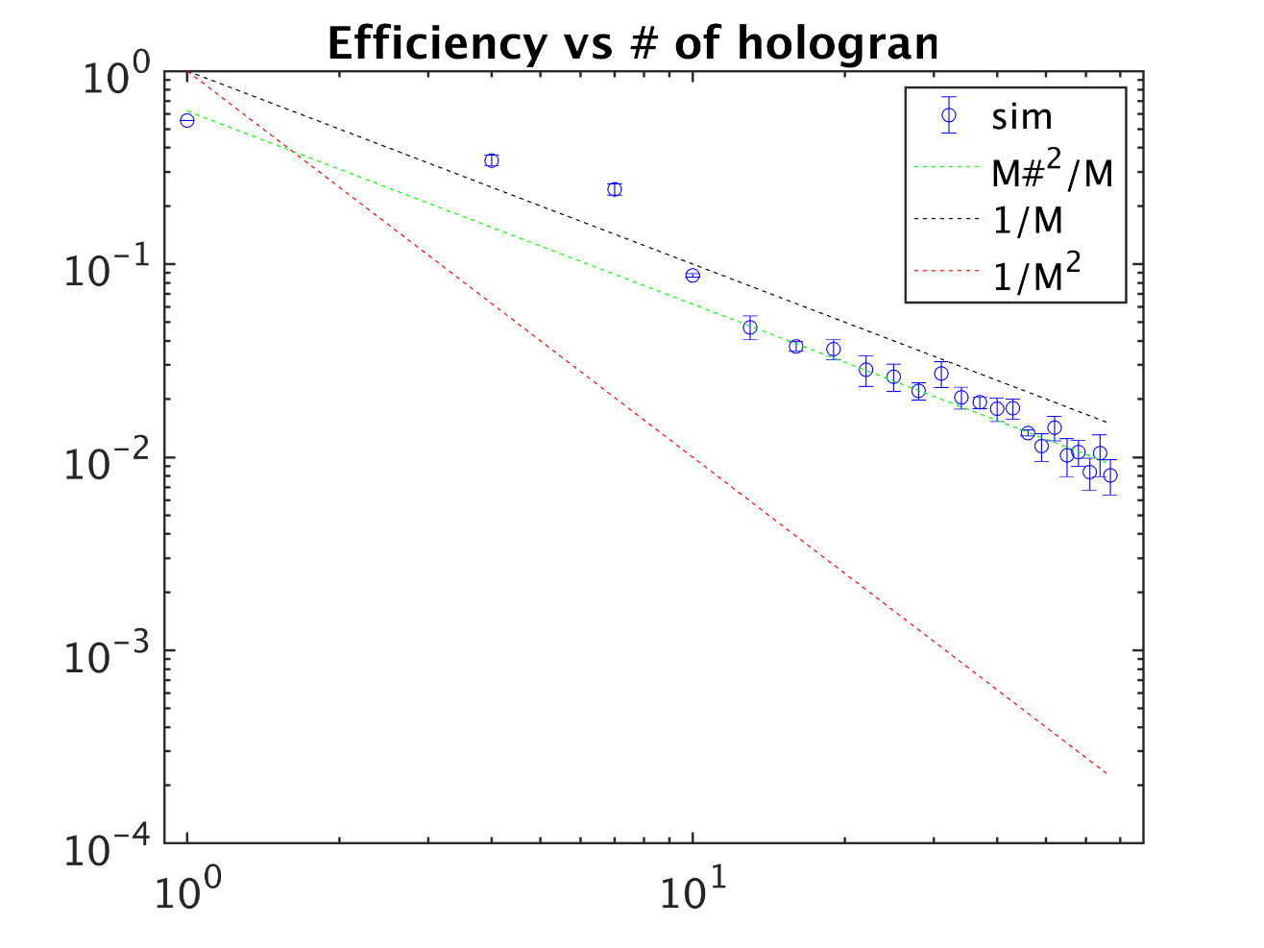
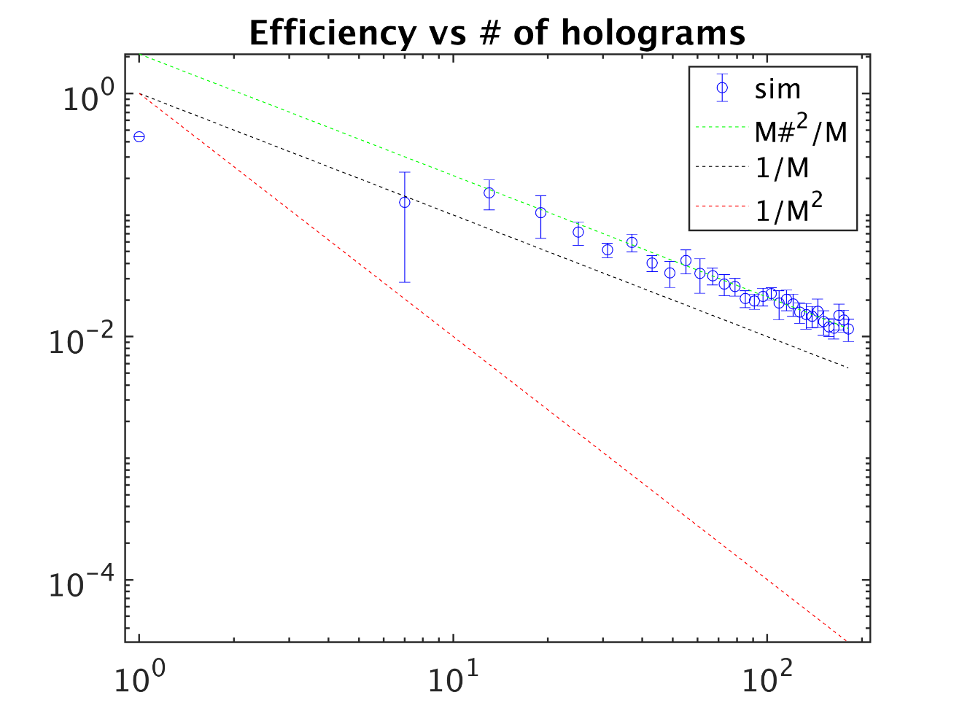
BPM verification of 1/M for angular-peristrophic multiplexing
14
~70 angles multiplexed in (200µm)³
~200 angles multiplexed in (400µm)³
Manuscript under preparation.

Slide 15
15
IP-S slanted gratings
Manuscript under preparation.
Notes:
Slanted VG LP15-75

Slide 16
Stitching for scale-up
16
3 blocks of (100µm)³
Manuscript under preparation.

Slide 17
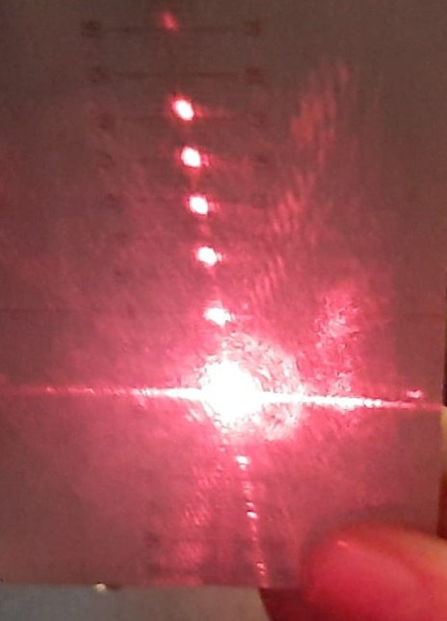
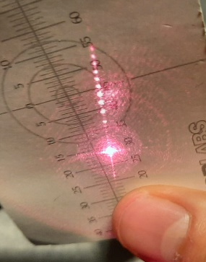
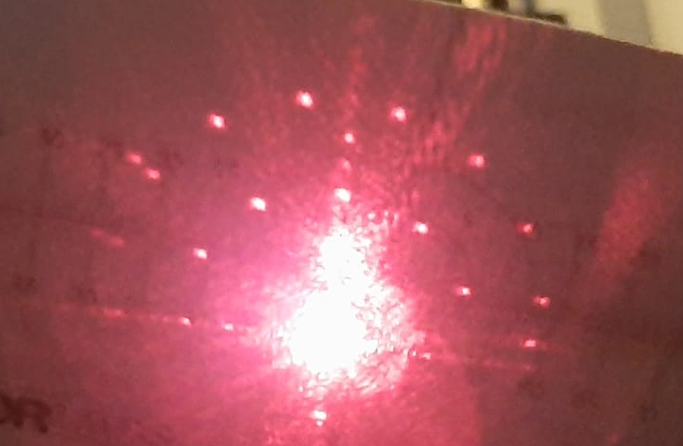
Conclusions
Snapshots from ongoing experiments
17
5
10
Digitally eliminate unwanted terms as a way of improving the efficiency
(3+1)D Printing to fabricate the filtered holograms
Early results with IP-Dip resin
Constraints due to fabrication: resolution and stitching
Calculations for the capacity w.r.t. IP-S resin
20

Slide 18
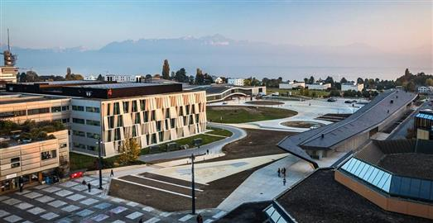



Thank You!
Any questions?
Niyazi Ulas Dinc
Prof. Christophe Moser
Prof. Demetri Psaltis

Slide 19


Discretization:
19
Angular Bragg selectivity:
Notes:
Min feq difference never kicks in. angle difference is always set by Bragg. Minimum period limits the number.

